Slide 1
EMG Analysis
PHASE 1

Slide 2
EMG
Preprocessing
Time-Normalization
Session Selection
Outlier Detection
Illustration
S1
S2
S3
S4
T
Preprocessing
General steps are filtering, rectification, and smoothing the signal with low-pass filter.
Tasks:
Study briefly (approx. 30 minutes) about the methods of preprocessing EMG data.
Get a full understanding of the provided code to you. Do the preprocessing on all EMG signals given to you.
I already have done this part and the data include the pre-processed EMG signals
Time-Normalization
Why? To compare muscle activity across all conditions (P1, P3, and P6), we need all signals to have the same length before averaging them for each individual.
Tasks:
To minimize interpolation, start by identifying the median signal length. Then, adjust each signal so that it matches the median length: shorter signals should be interpolated (upsampled), and longer signals should be down-sampled.

Slide 3
EMG
Preprocessing
Time-Normalization
Session Selection
Outlier Detection
Illustration
S1
S2
S3
S4
T
Outlier Detection
Outliers in EMG data can arise from sudden electrode shifts, transient hardware artifacts, or brief spikes of noise that do not reflect true muscle activity. These anomalies can skew or distort subsequent analyses. Therefore, identifying and marking them is crucial for accurate results.
Tasks:
Research Common Outlier Detection Methods Familiarize yourself with widely used strategies for detecting outliers in EMG data.
Mahalanobis Distance Metric We will use the Mahalanobis distance to detect outliers. Look for tutorials on YouTube or other sources to understand how this metric works.
Implementation Steps:
Segment the EMG Signals Divide each EMG signal into 10 segments. Compute the mean of each segment to form a 10-dimensional feature vector (1×10) for every signal.
Separate Epochs Carry out the above step separately for flexion and extension epochs, storing these feature vectors for each trial.

Slide 4
EMG
Preprocessing
Time-Normalization
Session Selection
Outlier Detection
Illustration
S1
S2
S3
S4
T
Outlier Detection (continue)
Tasks:
Implementation Steps:
Segment the EMG Signals Divide each EMG signal into 10 segments. Compute the mean of each segment to form a 10-dimensional feature vector (1×10) for every signal.
Calculate Mahalanobis Distance For each epoch, compute the Mahalanobis distance. Consider both session-specific analyses (four main sessions) and the entire experiment duration.
Use Robust Covariance Instead of classic covariance estimates, use a robust estimator like the Minimum Covariance Determinant (MCD) to improve the reliability of your outlier detection
In the main structure you will create at the end, the marked epochs as outlier should be imported so we can plot them later and see the algorithm performance in detecting the outliers.

Slide 5
EMG
Preprocessing
Time-Normalization
Session Selection
Outlier Detection
Illustration
S1
S2
S3
S4
T
Illustration
Tasks:
What we simply want here is to have figures that can show the muscles activity across our 3 conditions. Since we have five session selection options I expect 5 slides of figure as I show below each for one session option.
Slide
Title of the figure
The title here is important as it should show the selected session and whether outliers were ignored or not.
For example title can be like:
S1 – No Outlier Detection
Total – Outliers Ignored
S4 – Outliers Ignored
Flexion
Extension
Flexion
Extension
M1
(Knee Flexor)
M2
(Knee Flexor)
mV
mV
mV
mV
% cycle
% cycle
% cycle
% cycle
Flexion
Extension
Flexion
Extension
M3
(Knee Extensor)
M4
(Knee Extensor)
mV
mV
mV
mV
% cycle
% cycle
% cycle
% cycle
Note: Each colour shows one pressure condition. These curves are just for representation. In the main figure you should plot Mean and std. STD should be plotted as shaded area around the mean signal with transparency.

Slide 6
In Summary
Each subject requires 10 slides in total:
Five slides (S1, S2, S3, S4, and total) without outlier detection.
Five slides (S1, S2, S3, S4, and total) with outlier detection.
You can find the data link and the code for preprocessing in our notebook and the email I send to you.

Slide 7
EEG Analysis
PHASE 1

Slide 8
EEG
Time-Frequency content calculation
Apply Time-Warping
Illustration
EEG
We are working with epoched EEG data identified based on specific events. At this stage, our focus is on source-level activity (i.e., Independent Components or ICs) rather than channel-level signals.
Time-Frequency calculation
Tasks:
Review Existing Research You’ve already explored this topic; please revisit your notes and any relevant literature to refresh your knowledge.
Apply the Morlet-Wavelet Approach Compute the time-frequency representations for each epoch across all ICs and store these calculations within each trial.
Example: Suppose Subject S ends up with 52 ICs after preprocessing. For each trial (cell member) and each IC, you should produce a matrix of size F*T, where F is the number of frequencies and T is the number of time points. If you have M epochs in that trial, then you’ll store these results in a 1*M cell array. Each cell will contain a F*T*52 matrix that encapsulates the time-frequency content of all 52 ICs for that epoch.

Slide 9
EEG
Time-Frequency content calculation
Apply Time-Warping
Illustration
Time-Warping
Tasks:
Learn How Time-Warping Works Familiarize yourself with the practical details of time-warping in EEGLAB by exploring the make_timewarp function in:
~\EEGLAB\eeglab2024.2.1\functions\miscfunc\make_timewarp
Note: You’ll be the go-to person for showing everyone (including me) how to use it in practice!
Apply Time-Warping to EEG Data The goal is to ensure all epochs have the same length and are aligned to key time points (events).
Explanation:
Time-warping involves interpolating and down-sampling different segments of the signals according to important experiment events. Suppose each epoch contains three critical events:
Flexion_start,
Extension_start,
Flexion_end
After performing time-warping on the time-frequency data, we want all extension_start points across epochs to line up precisely, and the same goes for flexion_start and flexion_end. This way, when we average the time-frequency data, we can be confident that these event markers occur at the same time across all epochs.

Slide 10
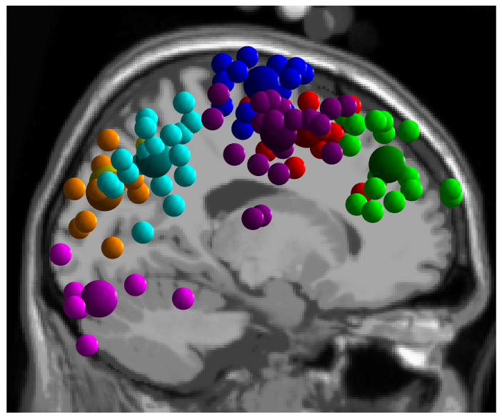
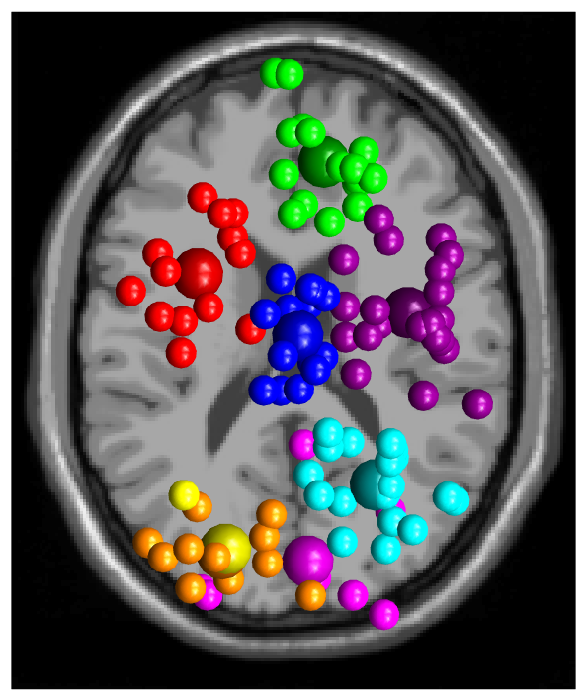
EEG
Time-Frequency content calculation
Apply Time-Warping
Illustration
Illustration
Tasks:
Plot Time-Frequency Figures
After completing the time-warping step, create three time-frequency plots—one for each PAM pressure condition (1, 3, and 6).
Additionally, plot the difference between pressure 3 and pressure 1, and between pressure 6 and pressure 1.
Create a General Script
Develop code that takes an IC ID as input and generates the corresponding time-frequency figures.
We’ll decide later which specific ICs to visualize.
Plan for Statistical Significance
We’ll use non-parametric approaches (e.g., permutation tests) to evaluate whether the observed differences are statistically significant. This will be addressed after completing Phase 1.
Focus on Key ICs
It’s impractical to plot every IC’s time-frequency data. Instead, once you have group-level and cluster-level results (pics on the right), focus on the relevant ICs in each cluster and plot the average time-frequency representations for those brain regions.

